Slide 1
SVM

Slide 2
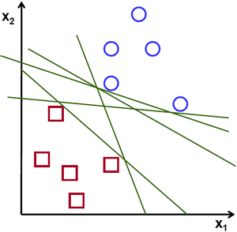
Which is the “best” Perceptron!

Slide 3
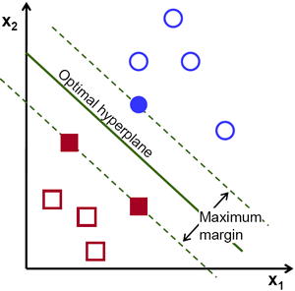
The “Best” Separation Boundary
Notes:
https://www.mathsisfun.com/data/straight_line_graph.html

Slide 4
Linear Support Vector Machines

Slide 5
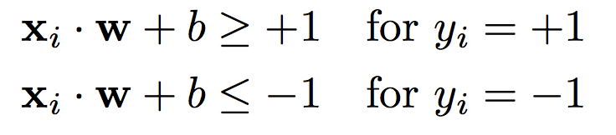

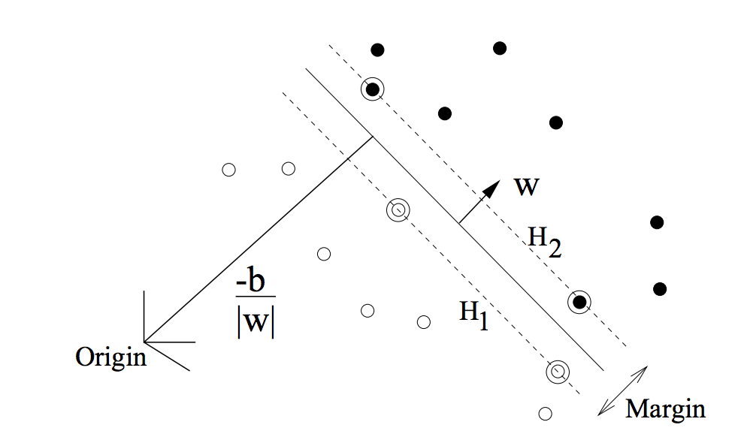
Linear Hyper-plane for 2-classes

Slide 6



Linear Hyper-plane for 2-classes

Slide 7
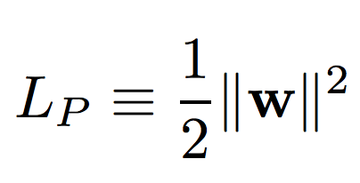
SVM Objective
OBJECTIVE:
CONSTRAINT:

Slide 8
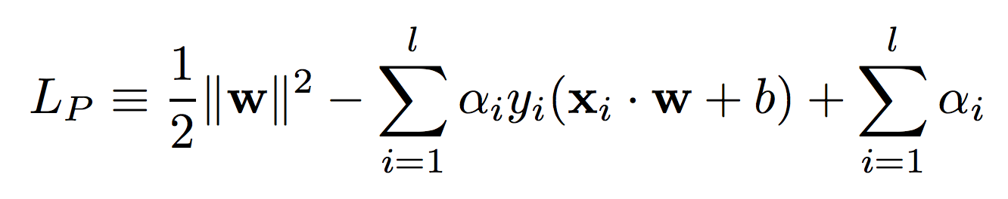
SVM Objective
OBJECTIVE:
CONSTRAINT:
Lagrange Multipliers

Slide 9
SVM Trick – 1 PRIMAL → DUAL

Slide 10
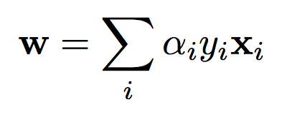
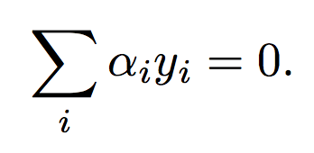
Solving the PRIMAL

Slide 11
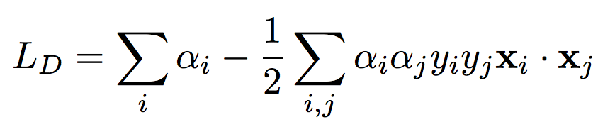
PRIMAL → DUAL

Slide 12
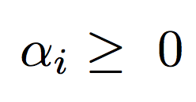
SVM Objective (DUAL)
OBJECTIVE: Minimize
CONSTRAINT:

Slide 13
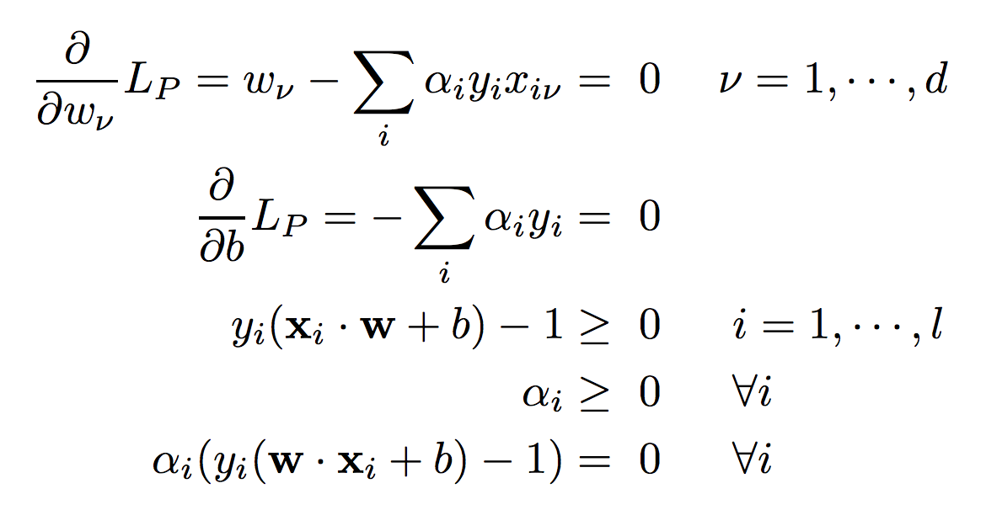
Karush-Kuhn-Tucker (KKT) condition

Slide 14
Support Vectors
Support Vectors

Slide 15
SVM Trick – 2 SLACK VARIABLES

Slide 16
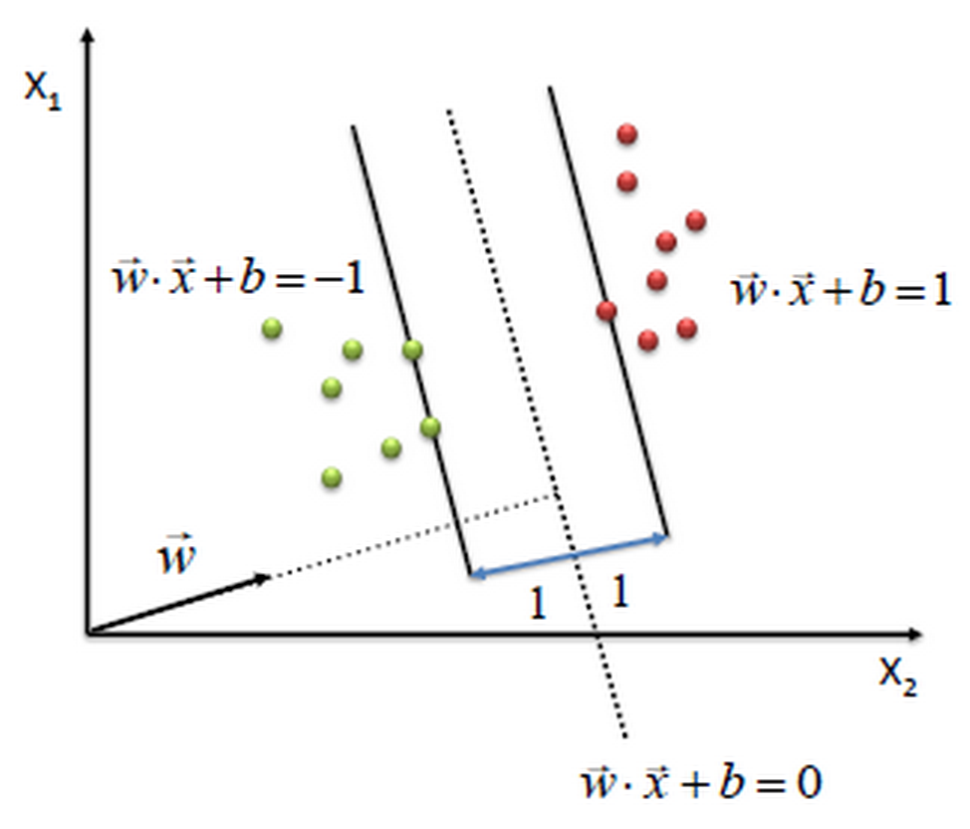
Separable Case

Slide 17
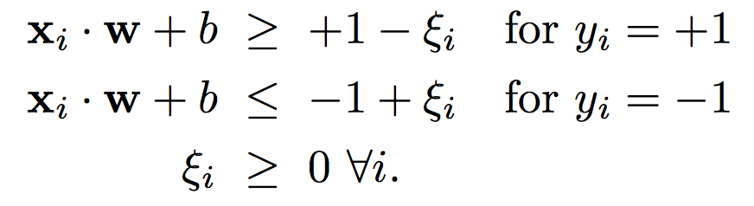
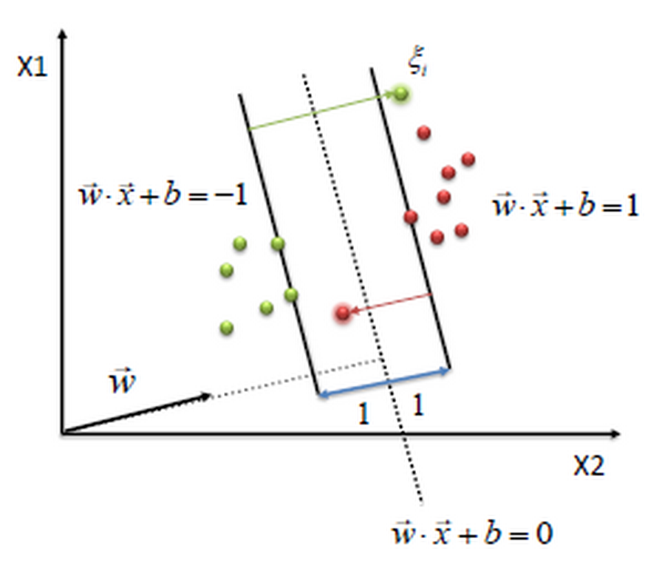
Non-Separable
Slack Variables

Slide 18
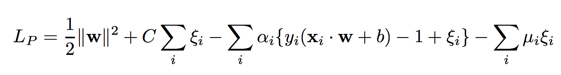
PRIMAL Objective
LINEARLY SEPARABLE CASE
LINEARLY NON-SEPARABLE CASE

Slide 19

DUAL Objective
LINEARLY SEPARABLE CASE
LINEARLY NON-SEPARABLE CASE

Slide 20
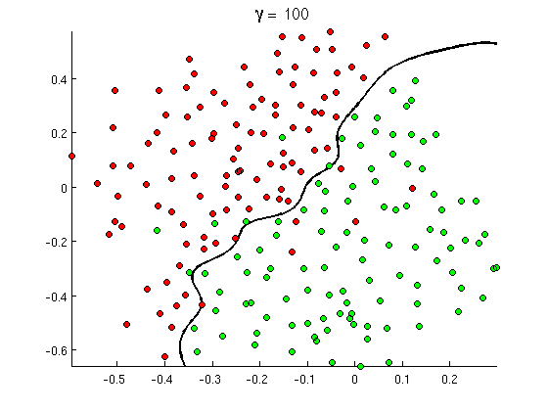
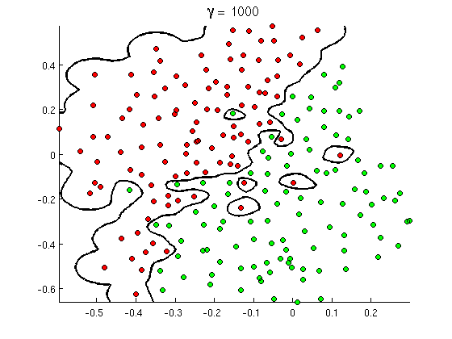
Tolerance for Slack → SVM Complexity

Slide 21
SVM Trick – 3 KERNEL TRICK

Slide 22
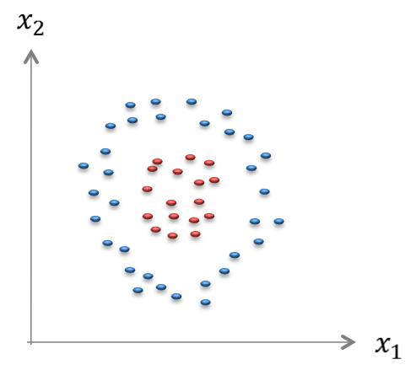
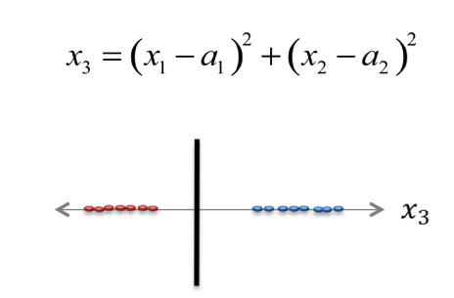
Feature Space Transformation
ORIGINAL FEATURE SPACE
Classes NOT LINEARLY SEPARABLE
TRANSFORMED FEATURE SPACE
Classes are LINEARLY SEPARABLE

Slide 23
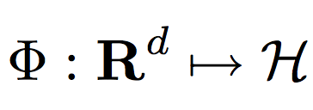
Increasing Model Capacity
LINEAR CLASSIFIERS
GENERALIZED LINEAR CLASSIFIERS

Slide 24
KERNEL TRICK

Slide 25
SVM Kernels
KERNEL FUNCTION

Slide 26
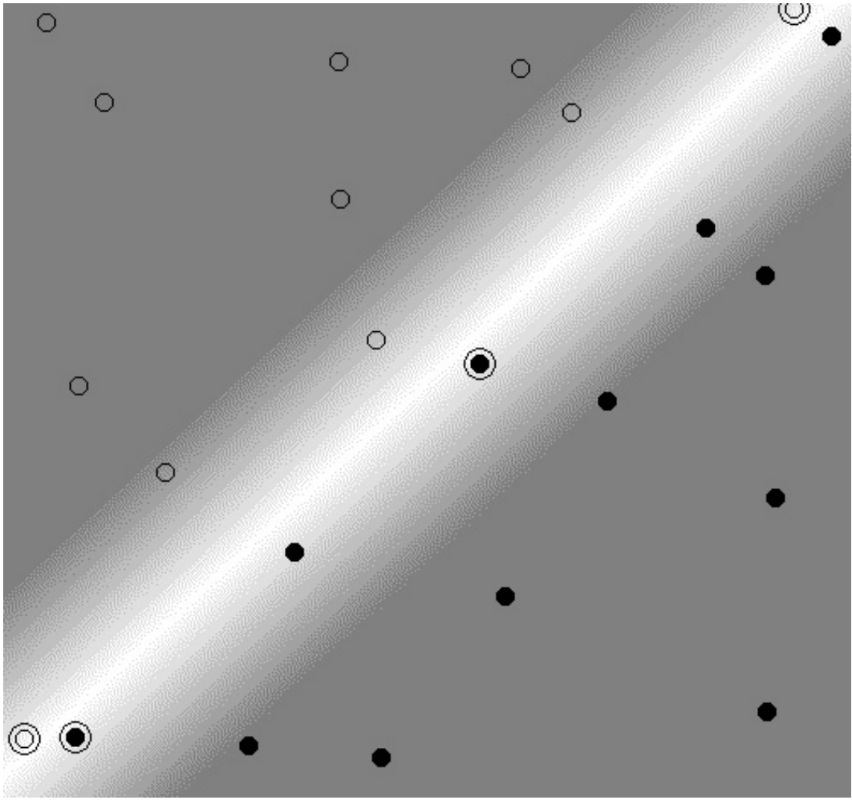
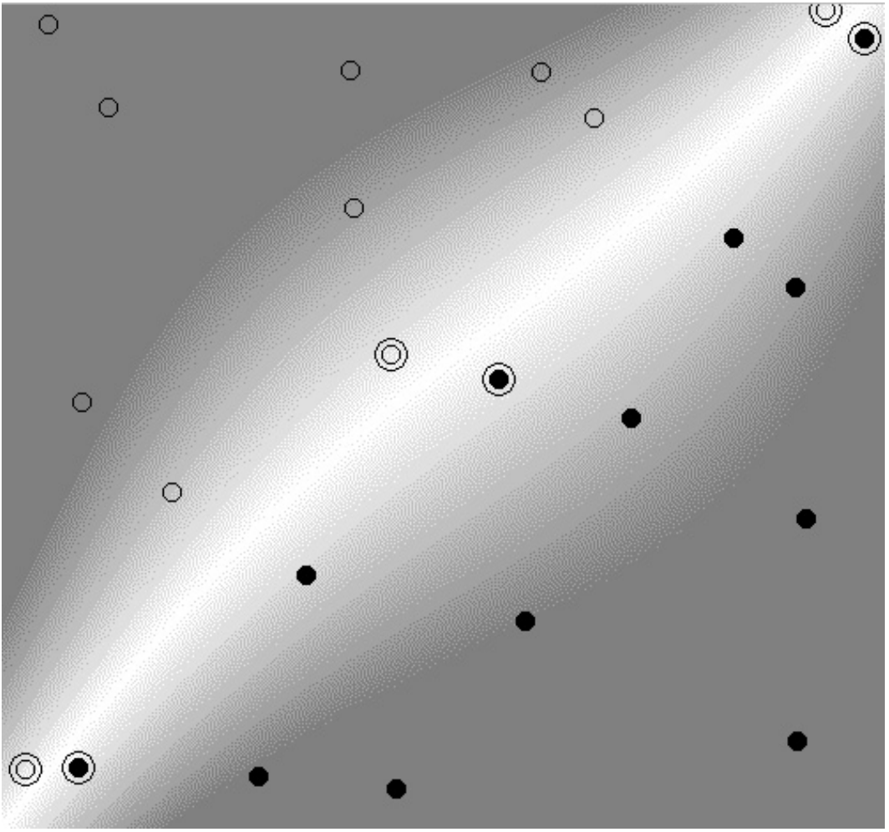
Polynomial Kernel / Separable

Slide 27
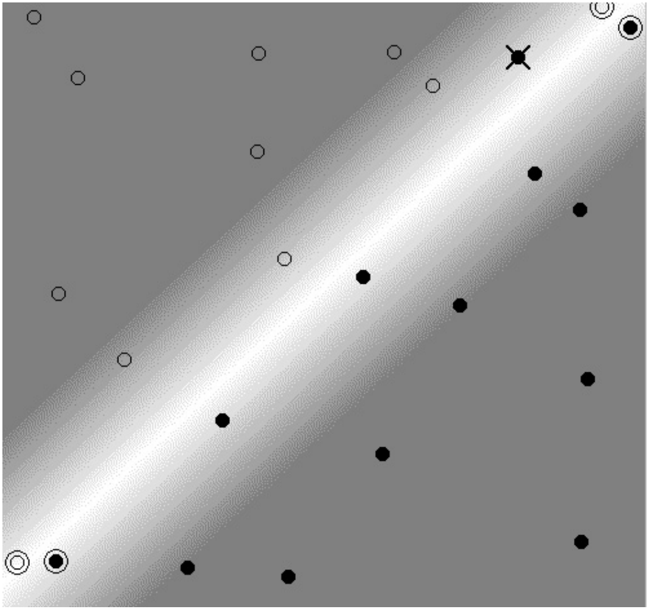
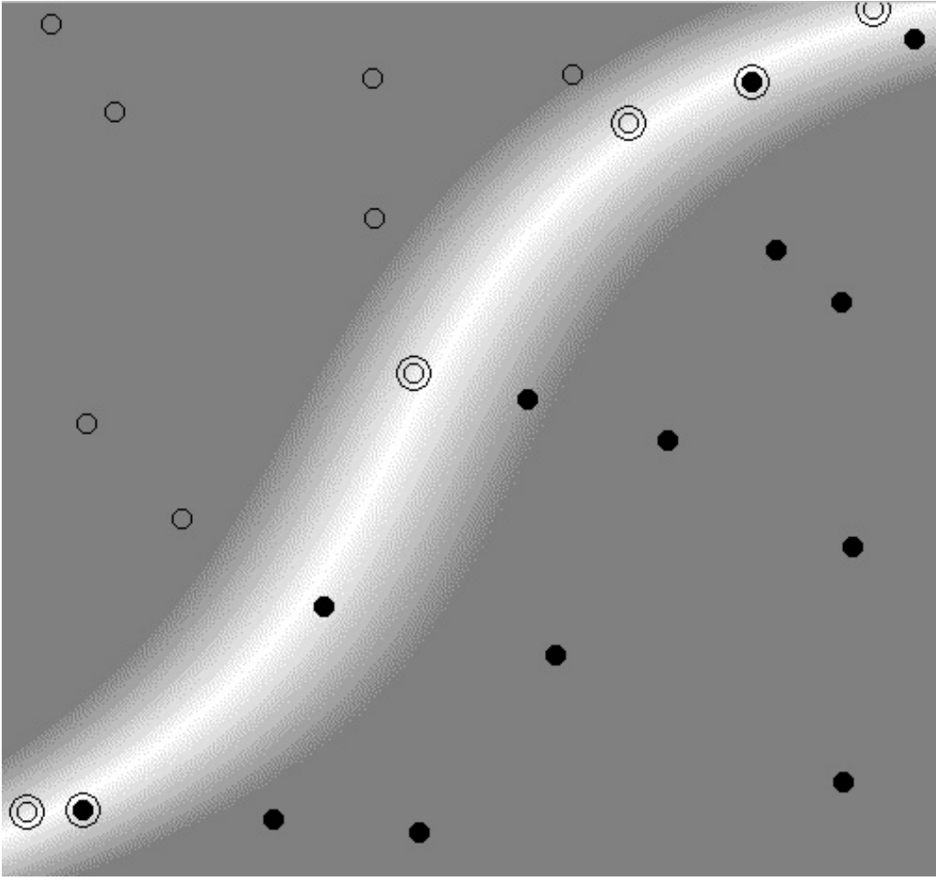
Polynomial Kernel / Non-Separable

Slide 28
Polynomial Kernel

Slide 29
RBF Kernels

Slide 30
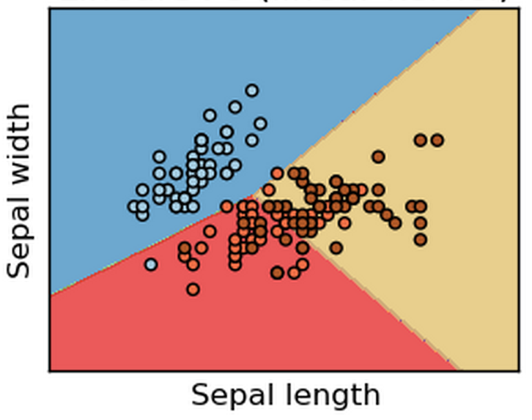
Linear SVM

Slide 31
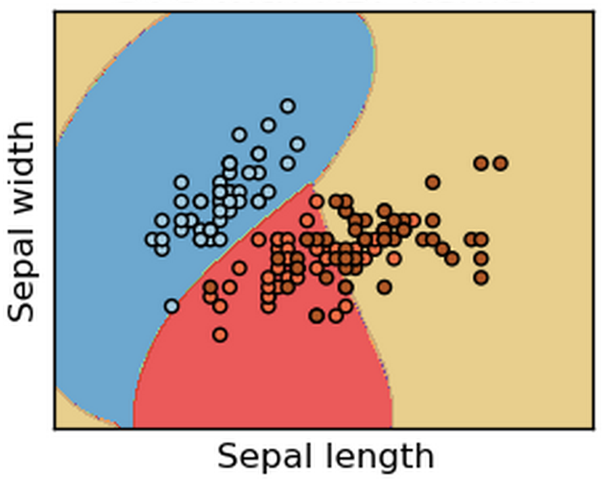
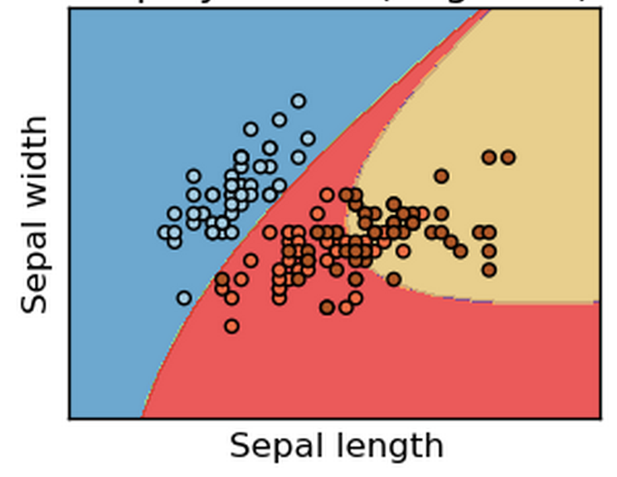
Non-Linear SVM

Slide 32
Summary in SVM
Learning an SVM Classifier
Trick 1 : PRIMAL → DUAL (Support Vectors)
Trick 2 : SLACK Variables
Trick 3 : Kernels
What kind of model is this?
What is the model?
What are the parameters?
What is complexity?
SCORING using SVM Classifier

Slide 33
Assignment – Due by 22nd April
Join Digit Recognizer competition on Kaggle as team (with respective partner). Use SVM to classify the data and make your submission.
Share the screenshot of your submission score from Public Leader board by 22nd April
To learn more about C and Gamma read here
Watch this video to learn more about the math of margin:
https://www.youtube.com/watch?v=QKc3Tr7U4Xc

